Slide 1
EDA Credit Case Study
Akila Reddy
Kanaka Roshini

Slide 2
The loan providing companies find it hard to give loans to the people due to their insufficient or non-existent credit history. Because of that, some consumers use it as their advantage by becoming a defaulter. Suppose you work for a consumer finance company which specializes in lending various types of loans to urban customers. You have to use EDA to analyze the patterns present in the data. This will ensure that the applicants capable of repaying the loan are not rejected.
When the company receives a loan application, the company has to decide for loan approval based on the applicant’s profile. Two types of risks are associated with the bank’s decision:
If the applicant is likely to repay the loan, then not approving the loan results in a loss of business to the company
If the applicant is not likely to repay the loan, i.e. he/she is likely to default, then approving the loan may lead to a financial loss for the company.
This case study aims to identify patterns which indicate if a client has difficulty paying their installments which may be used for taking actions such as denying the loan, reducing the amount of loan, lending (to risky applicants) at a higher interest rate, etc. This will ensure that the consumers capable of repaying the loan are not rejected. Identification of such applicants using EDA is the aim of this case study.

Slide 3
Data Understanding
This dataset has 3 files as explained below:
1. 'application_data.csv' contains all the information of the client at the time of application. The data is about whether a client has payment difficulties.
2. 'previous_application.csv' contains information about the client’s previous loan data. It contains the data whether the previous application had been Approved, Cancelled, Refused or Unused offer.
3. 'columns_description.csv' is data dictionary which describes the meaning of the variables.

Slide 4
Data Analysis
Imported required libraries and load the data using read_csv
Data cleaning is done by dropping columns which has more than 30% missing values
Imputation on some key columns AMT_ANNUITY, AMT_GOODS_PRICE, NAME_TYPE_SUITE, CNT_FAM_MEMBERS, EXT_SOURCE_2, OCCUPATION_TYPE
Outliers are checked for numerical columns and handled in all required columns. Categorical missing values are identified and handled using mode
Data type errors are identified and converted for the required columns
Continuous Variables are binned

Slide 5
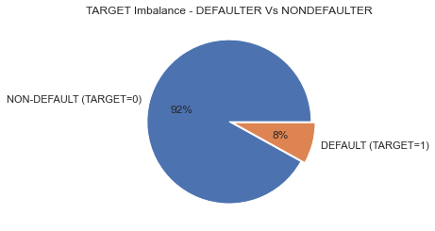
Target Imbalance
92% of people have not defaulted as opposed to 8% who have defaulted on their payment

Slide 6
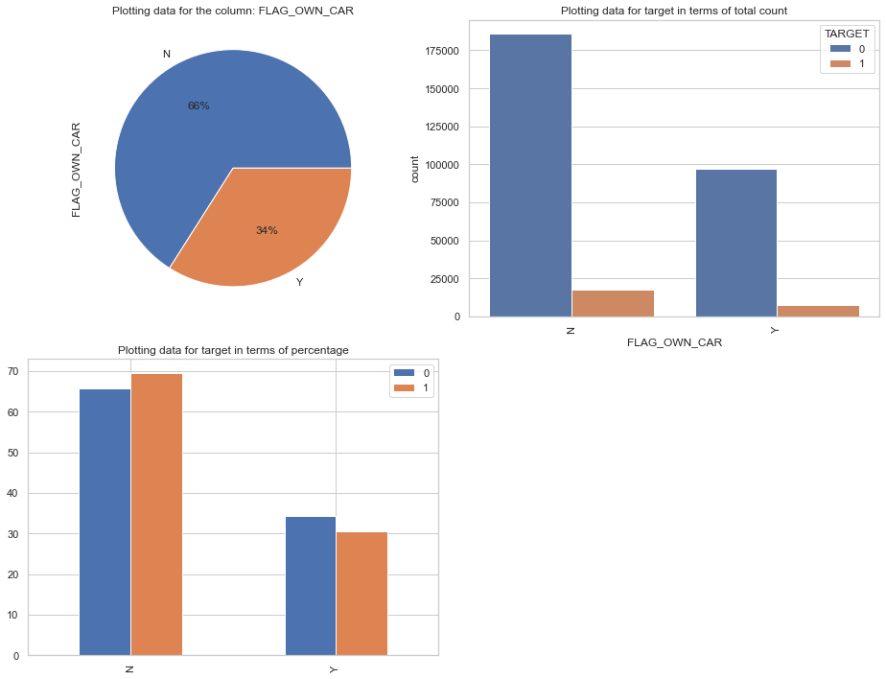
Perform univariate analysis on categorical columns
Around 70% of defaulters don't own a car and around 30% of people default who do own a car so rate of default for people who own a car is lower than those who don't

Slide 7
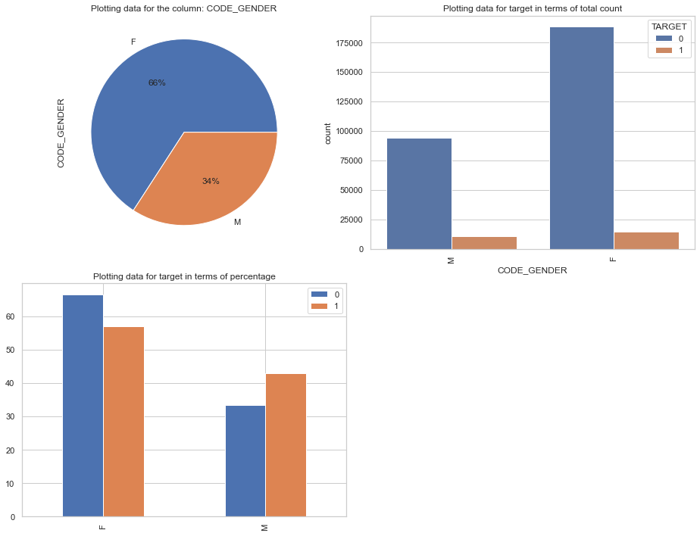
We can see that Female contribute more than 60% to the non-defaulters while around 50% to the defaulters. We can conclude that We see more female applying for loans than males and hence the more number of female defaulters as well. Males apply for less loans but default more

Slide 8
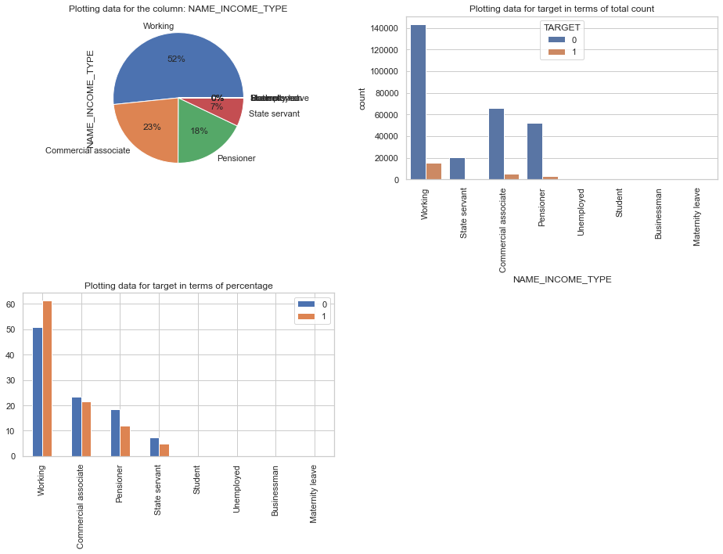
People who work default the most and the least are state servant and pensioners as opposed to the loans they take

Slide 9
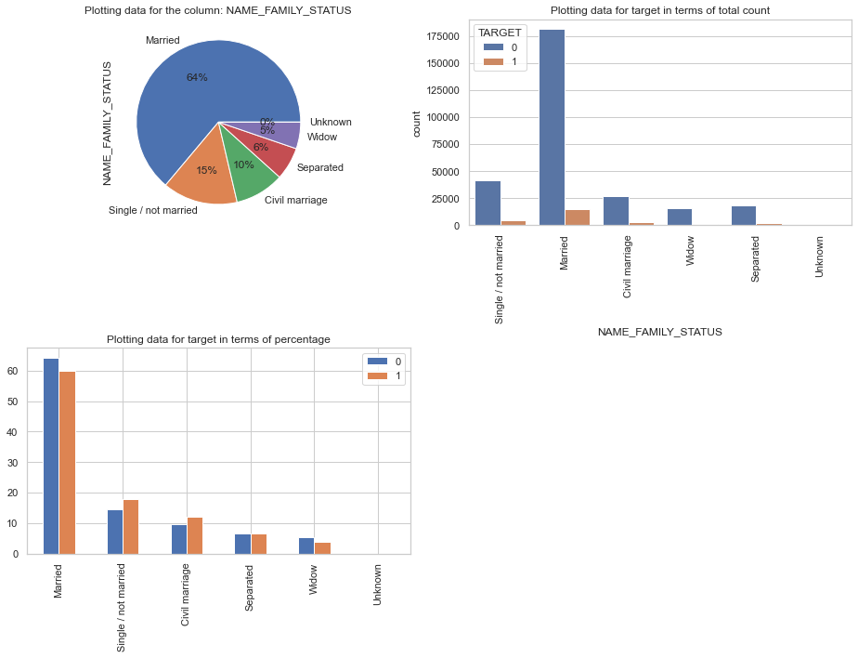
Married people applied for the most loans but single/not married people default rate is higher compared to the loans they applied same with civil marriage

Slide 10
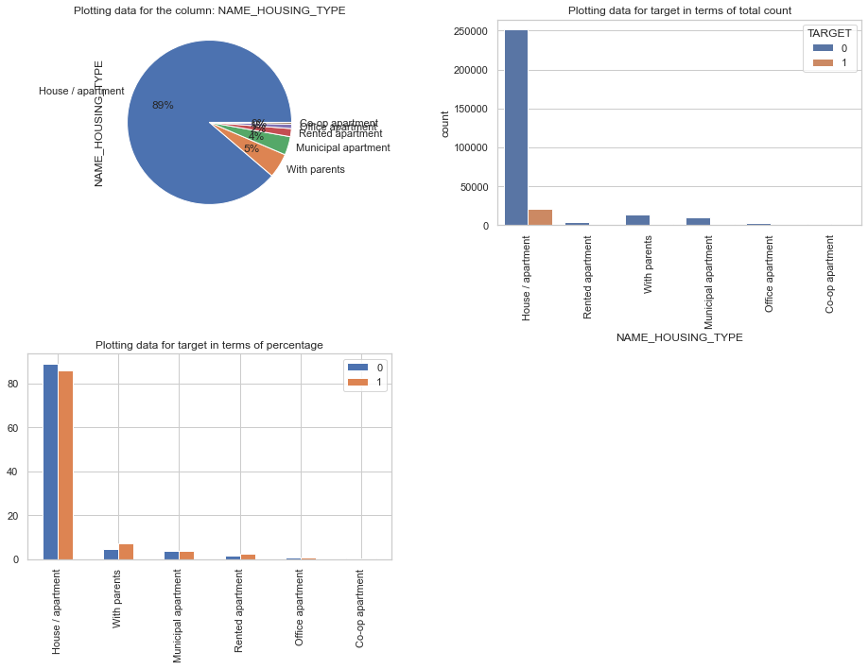
Riskiest People living with parents tend to default the most even though they took lower percentage of loans

Slide 11
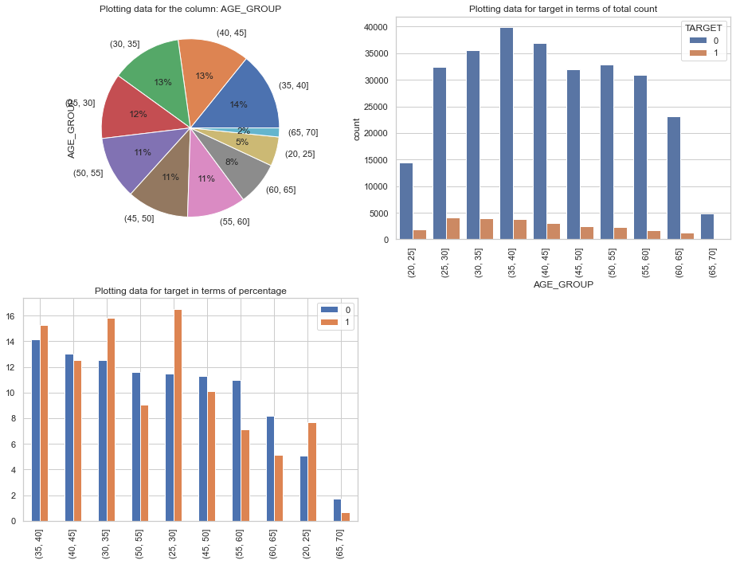
Univariate categorical ordered analysis
Riskiest age group is between 25-30 they defaulted more. the higher the age lower the defaults due to job stability

Slide 12
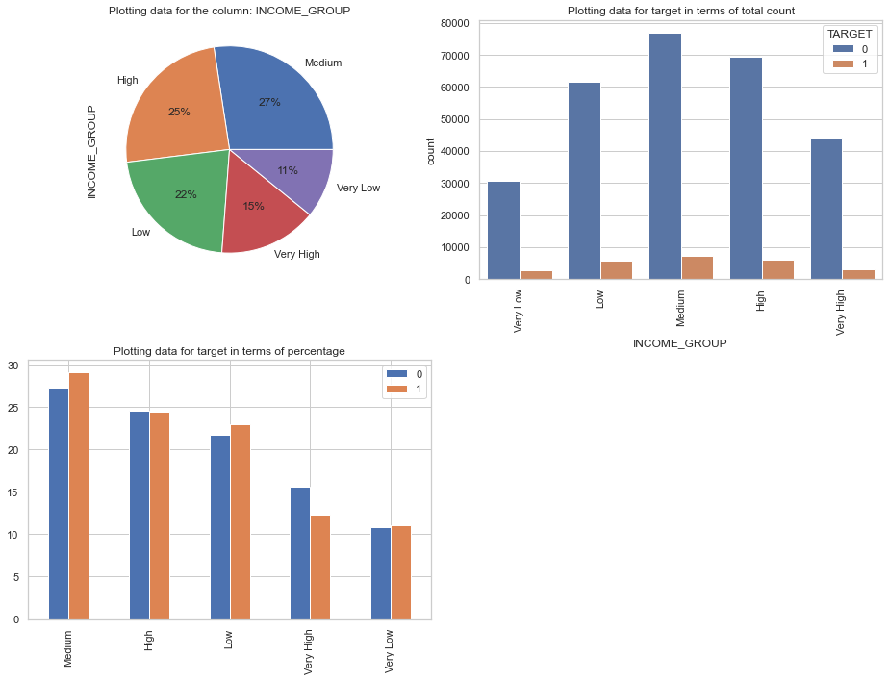
Medium income groups defaulted the most so did the low income group but only slightly

Slide 13
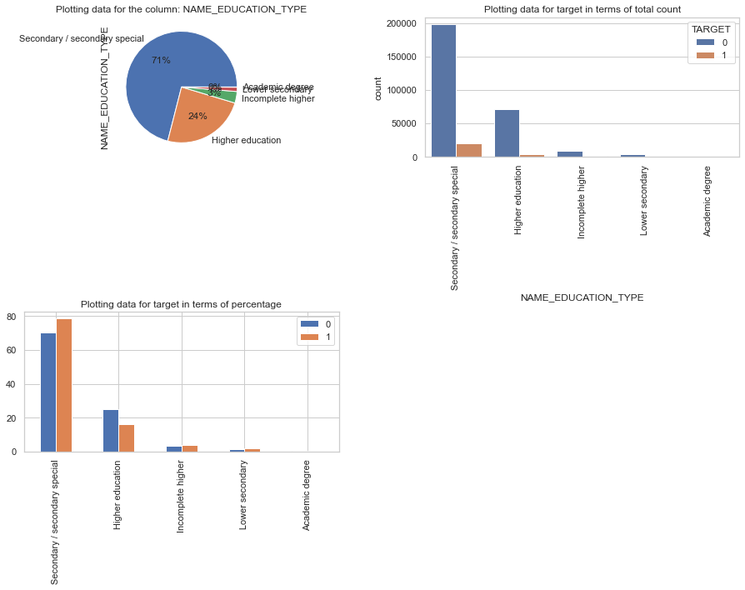
Customer with secondary education defaulted the most and the lowest is people with academic degrees
Customer borrowing from regions with rating 3 tend to default the most
Customer who lived with parents defaulted higher than those who own or rent

Slide 14
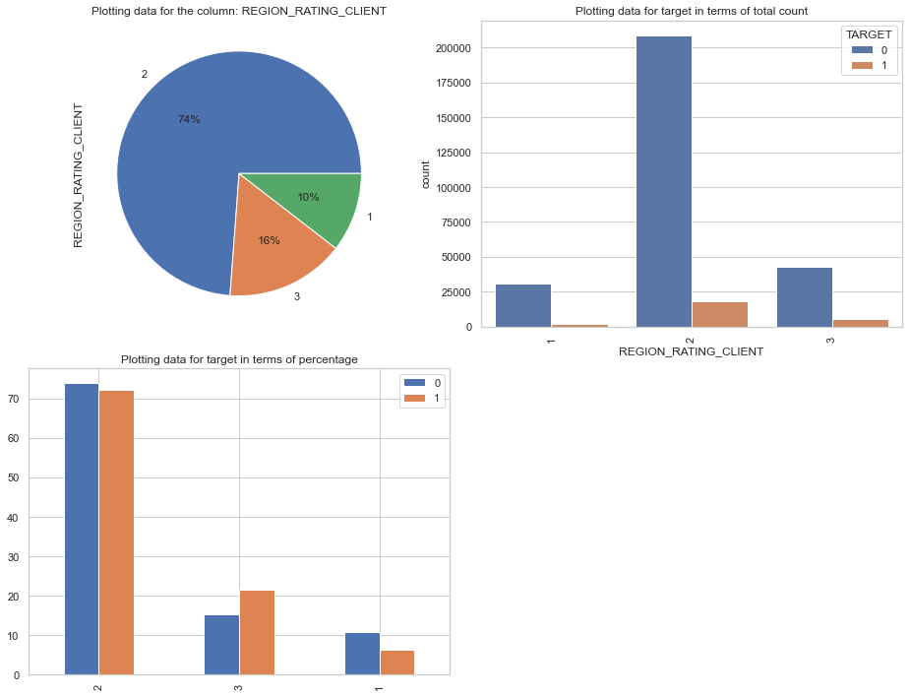
Univariate analysis and outliers for Numerical cols
Region rating client 2 has more percentage for both Defaulters and Non-Defaulters

Slide 15
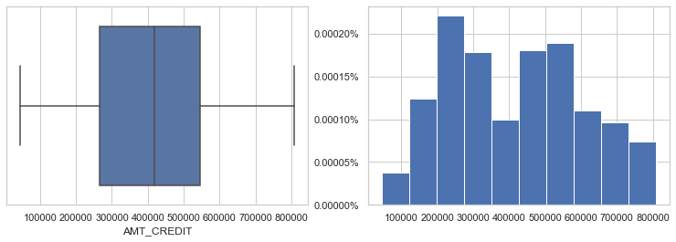
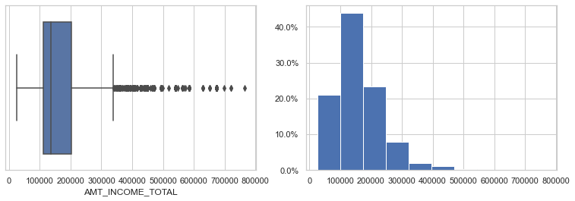
Around 50% of people took a loan between 200000 and 600000
Most of the defaulters have the income range between 100000 and 200000

Slide 16
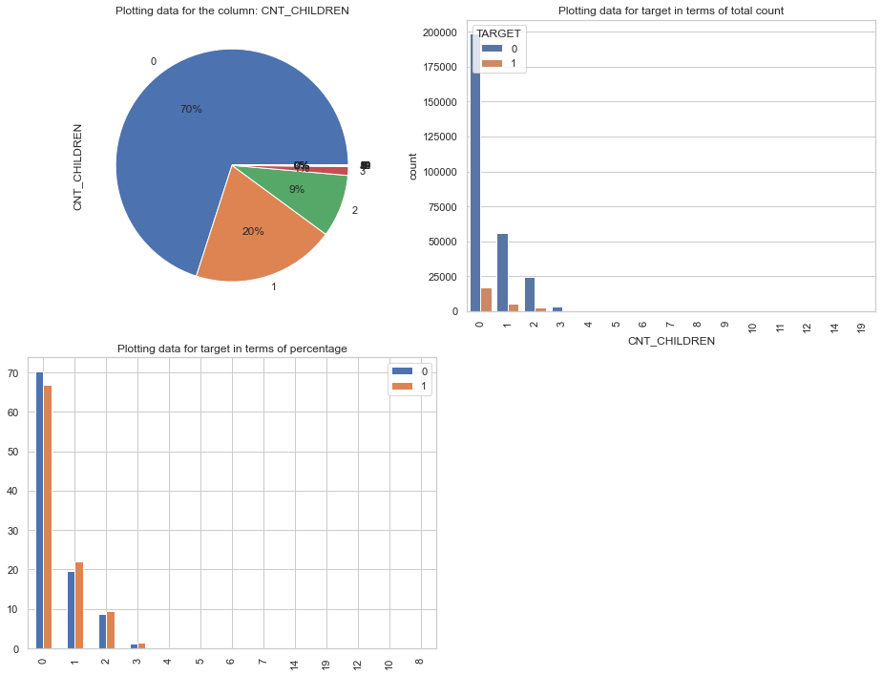
People without children defaulted less

Slide 17
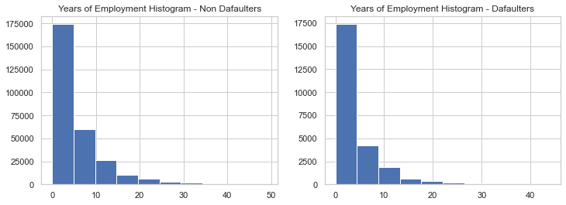
People defaulted less in the later parts of their career i.e >10 years

Slide 18
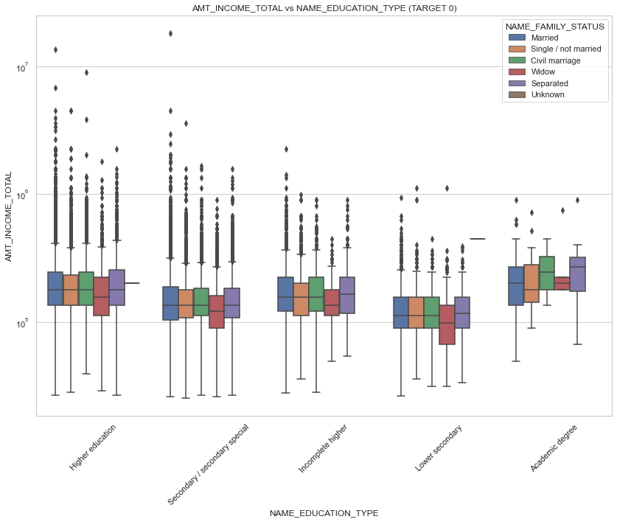
Bivariate analysis
Academic degree education type have less outliers and also their amount income total seems to be on higher side. The income range is also about the same. People with lower secondary education have the lowest income

Slide 19
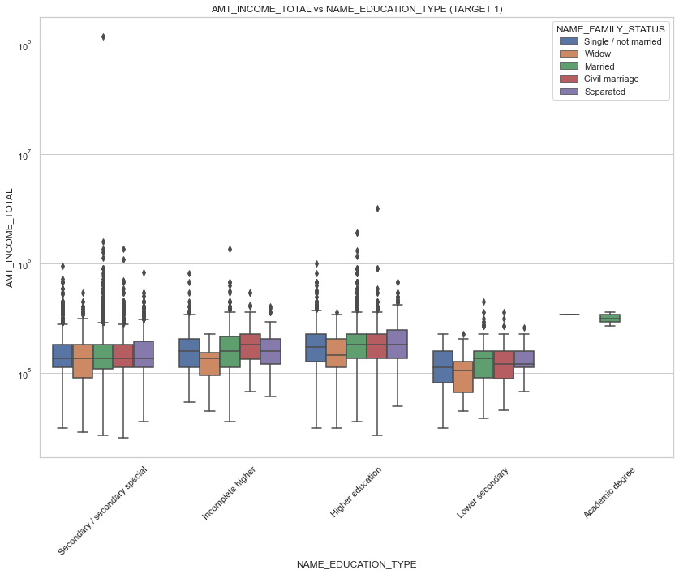
Academic degree education type have no outliers and also their amount income total seems to be on higher side. The income range is also about the same. People with lower secondary education have the lowest income

Slide 20
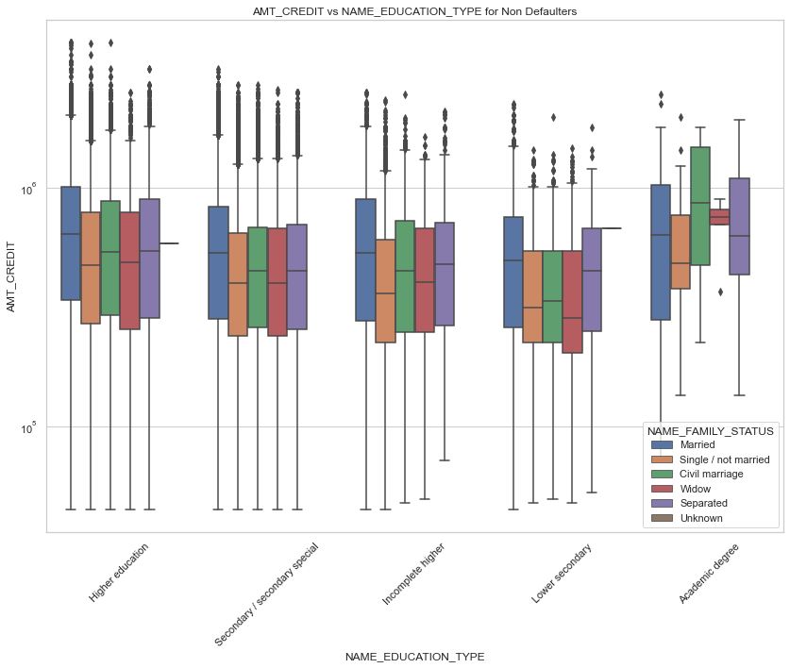
On Average people with lower secondary degree received lower amount of credit and Academic degree holders received the highest for defaulters

Slide 21
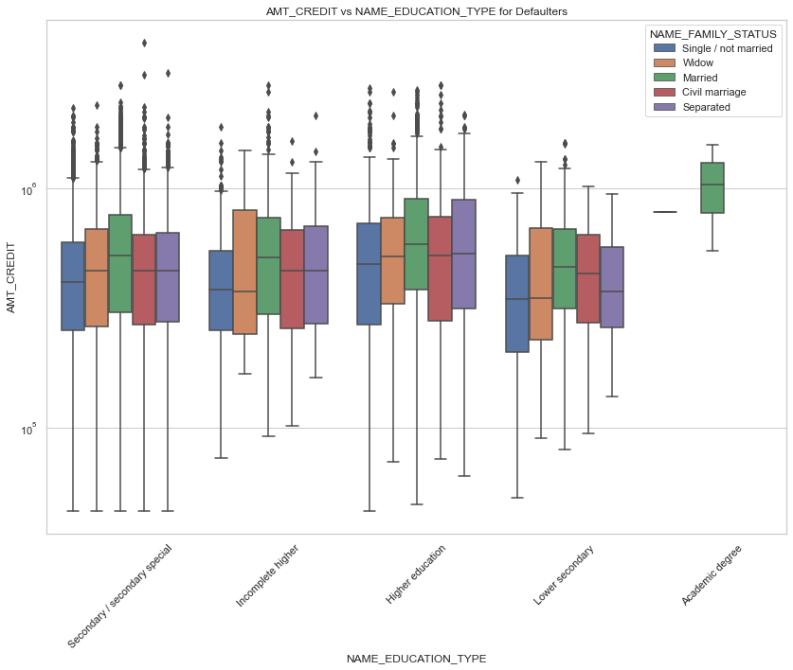
On Average people with lower secondary degree received lower amount of credit and Academic degree holders received the highest for non Defaulters

Slide 22
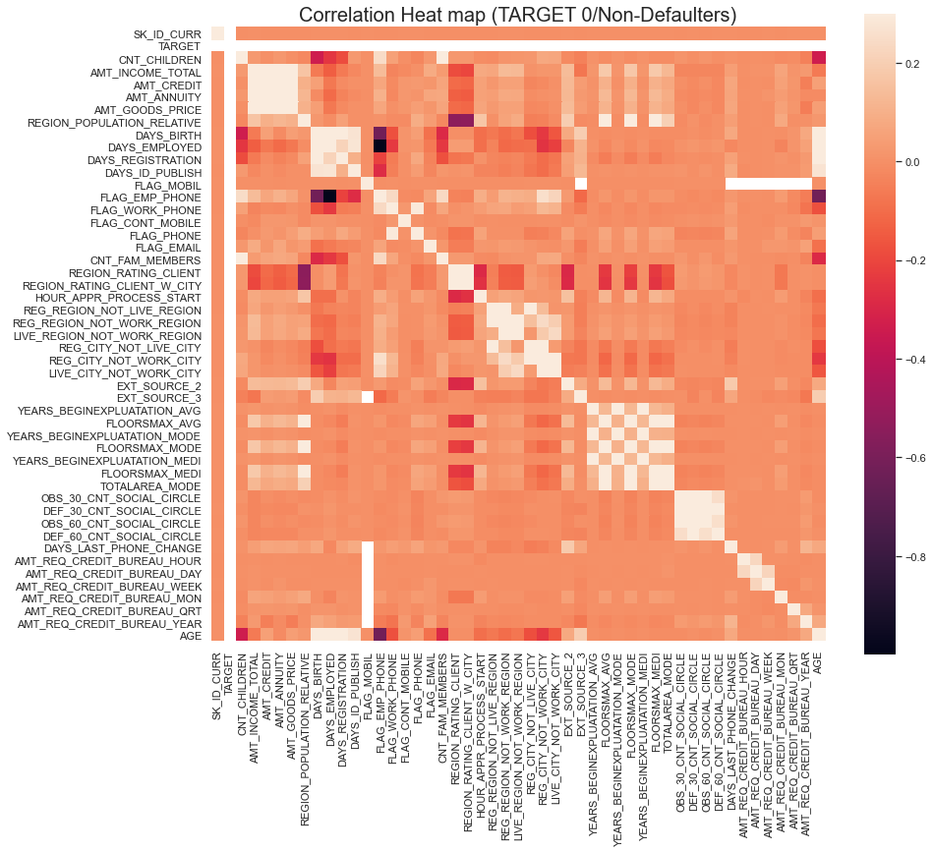
Correlation
Top 10 Higher correlation for non-Defaulters
FLAG_EMP_PHONE, DAYS_EMPLOYED
AGE, DAYS_BIRTH
OBS_60_CNT_SOCIAL_CIRCLE, OBS_30_CNT_SOCIAL_CIRCLE
FLOORSMAX_MEDI, FLOORSMAX_AVG
YEARS_BEGINEXPLUATATION_MEDI, YEARS_BEGINEXPLUATATION_AVG
FLOORSMAX_MEDI, FLOORSMAX_MODE
AMT_GOODS_PRICE, AMT_CREDIT
FLOORSMAX_MODE, FLOORSMAX_AVG
YEARS_BEGINEXPLUATATION_MODE, YEARS_BEGINEXPLUATATION_AVG
YEARS_BEGINEXPLUATATION_MEDI, YEARS_BEGINEXPLUATATION_MODE

Slide 23
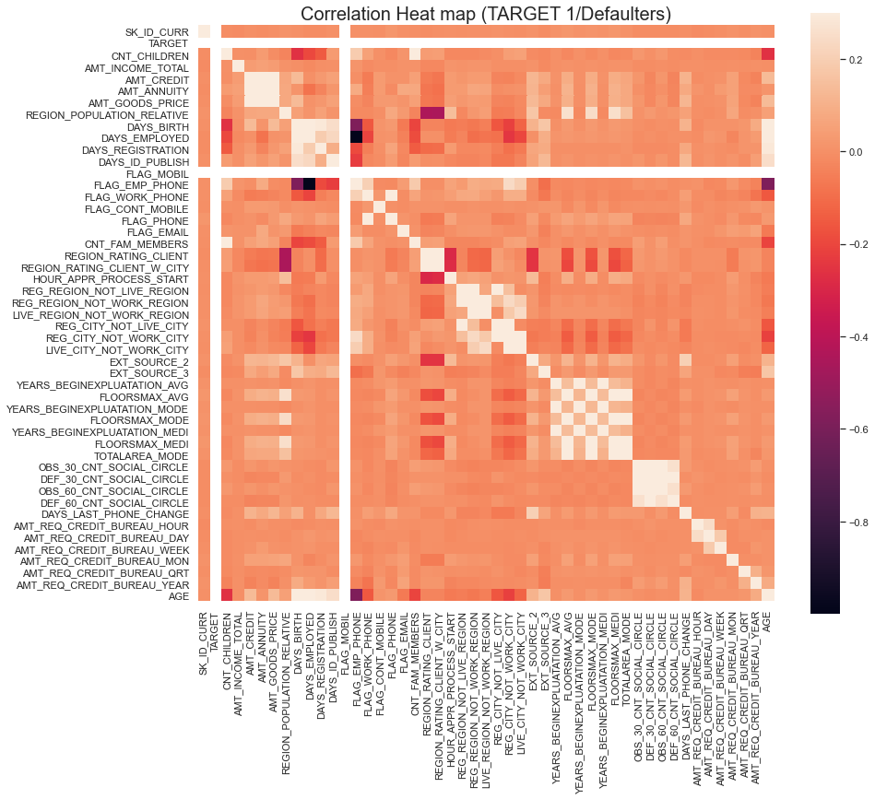
Top 10 Higher correlation for non-Defaulters
FLAG_EMP_PHONE, DAYS_EMPLOYED
AGE, DAYS_BIRTH
OBS_60_CNT_SOCIAL_CIRCLE, OBS_30_CNT_SOCIAL_CIRCLE
FLOORSMAX_MEDI, FLOORSMAX_AVG
YEARS_BEGINEXPLUATATION_MEDI, YEARS_BEGINEXPLUATATION_AVG
FLOORSMAX_MEDI, FLOORSMAX_MODE
FLOORSMAX_MODE, FLOORSMAX_AVG
AMT_GOODS_PRICE, AMT_CREDIT
YEARS_BEGINEXPLUATATION_MODE, YEARS_BEGINEXPLUATATION_AVG
YEARS_BEGINEXPLUATATION_MEDI, YEARS_BEGINEXPLUATATION_MODE

Slide 24
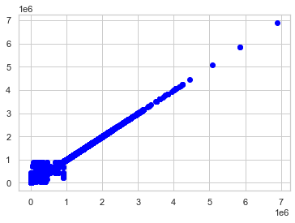
Previous Application Data Analysis
AMT_GOODS_PRICE and AMT_APPLICATION having linear relationship. Its observed both values are being same. Amount of application is equal to the amount of goods price

Slide 25
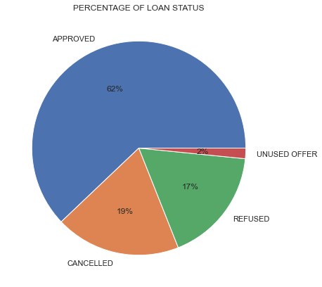
Loan approved status is higher in previous application. Approved loan is 62% where Cancelled, Refused is around 36%

Slide 26
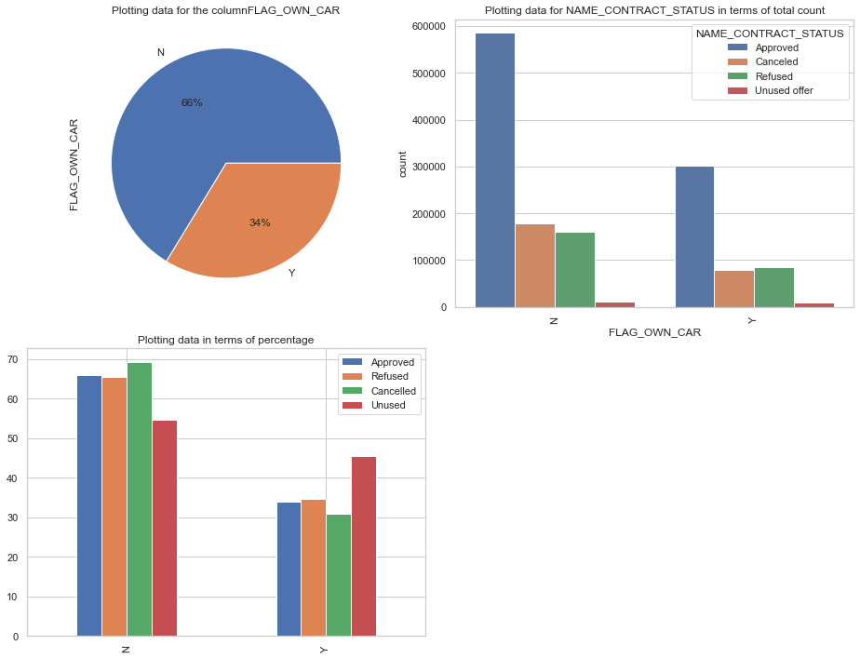
Perform univariate analysis ON PREVIOUS APPLICATION
Count of approved data and count of people who took loan is more among that People who doesn't own a car

Slide 27
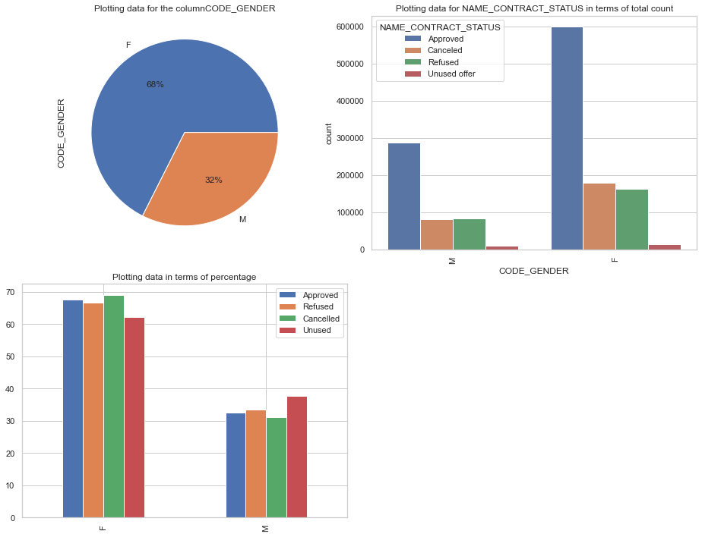
Female tend to get more loan and approval status count is more for Female.

Slide 28
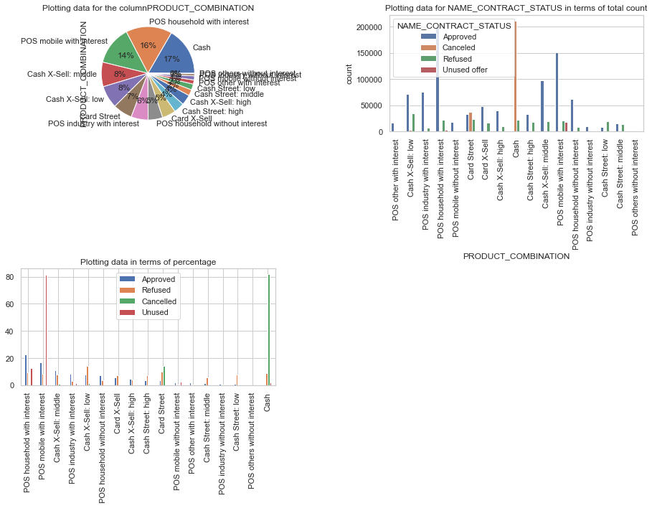
Refused loan percentage is more for POS mobile with Interest product and cancelled loan for cash product is higher

Slide 29
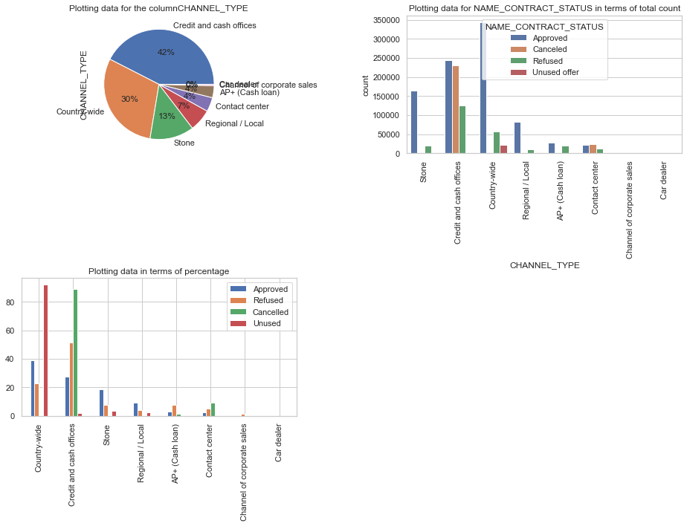
Approved loan for country wide is higher and credit and cash offices is the next highest

Slide 30
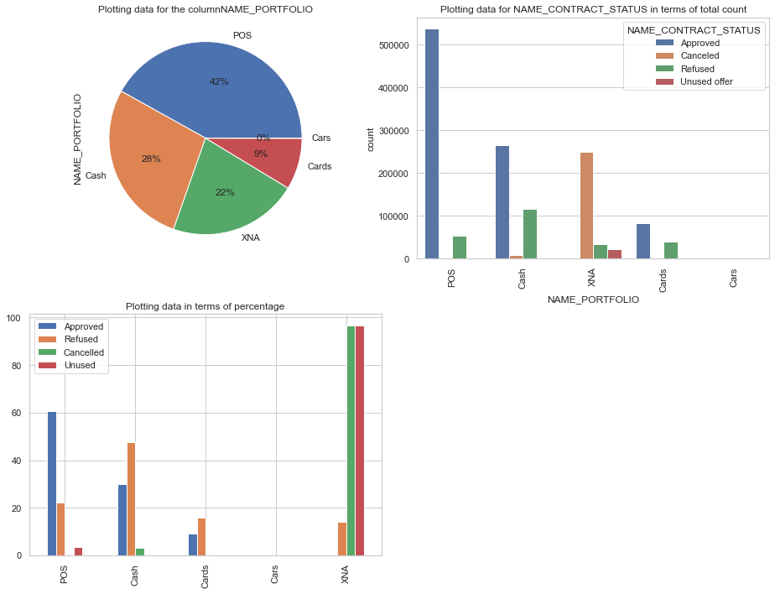
Cash has more refused data than other Name_Portfolio and POS is higher in approved loan

Slide 31
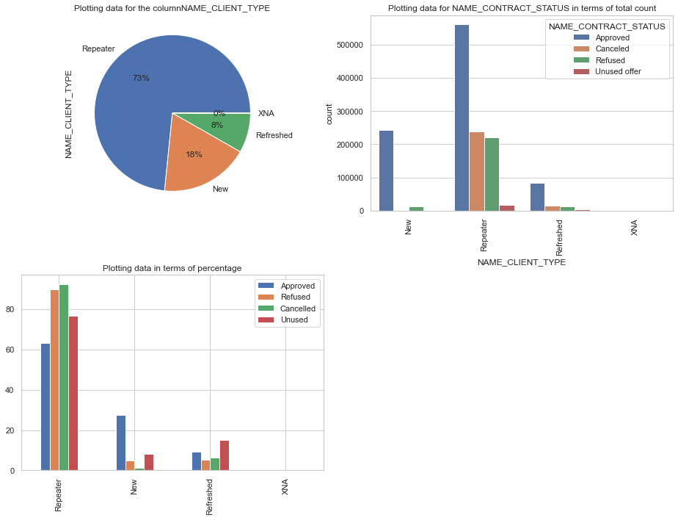
Repeater took more loans compared to others and they have more percentage of Refused, Cancelled and unused loans
Refreshed unused loans percentage is more compared to other status of Refreshed

